Slide 1

Teams & SharePoint Document Management
Melanie Culver
@CulverMelanie​
Brought to you by:
The Global Microsoft Community &
#M365VM
M365VirtualMarathon.com
M365Conf.com | #M365CONF

Slide 2
Session Description
Microsoft Teams is all over the place and everyone is keen to creating his/her own team to start collaborating. Other people still want to stick with SharePoint and manage their documents there, instead of in Teams. If you grant your users maximum flexibility, they will create and work on documents all over the place, in Teams or directly in SharePoint. This is condemned to create sooner or later unhappy users, because they cannot find the content they are looking for.
This session will show you how you can apply your bit of governance to make your users life easier. You will hear about an approach where you can make use of the best of both worlds and your users will still be able to find the documents they are looking for. We will look into Hub-Sites, applying basic metadata in the background to all your documents and therefore make them findable again through SharePoint Search. All done with some configuration and for scaling purposes, using automated provisioning with Azure Functions and PowerShell.
Highlights
Document Management in Teams & SharePoint
Apply governance to your Teams & SharePoint Documents
Find your documents

Slide 3

Mark Your Calendars:
March 23-25, 2021, MGM Grand Resort
Las Vegas, Nevada, USA
M365Conf.com
#M365CONF
The SharePoint Conference is now The Microsoft 365 Collaboration Conference
Brought to you by:
The Global Microsoft Community &
#M365VM
M365VirtualMarathon.com
M365Conf.com | #M365CONF

Slide 4










THANK YOU TO ALL OUR GENEROUS SPONSORS

Slide 5

ARE YOU READY FOR A RAFFLE? We are giving away 3 Oculus Quest All In One!
Visit the Vendors Booth, Sessions and Watch the Videos
Submit Your Answers to Enter the Raffle
You need at least 5 correct answers then submit for a chance to win one of 3
(One in each Americas, APAC, EMEA)
https://bit.ly/m365raffle

Slide 6





CONSIDER DONATING TO THE FOLLOWING CHARITY RELIEF FUNDS: UNITED WAY OR INTERNATIONAL MEDICAL CORPS
THANK YOU FOR JOINING US! 10% OF FUNDS FROM SPONSORS GO TO SUPPORT COMMUNITY RELIEF
United Way: https://give.uwkc.org/M365VM
International Medical Corps: https://bit.ly/MedicalCorpsFund

Slide 7




Melanie Culver
Consultant & Solution Architect M365
International Organisation
Vienna, Austria
Brought to you by:
The Global Microsoft Community &
#M365VM
M365VirtualMarathon.com
M365Conf.com | #M365CONF
Notes:
Kudos to my team in the office as well

Slide 8
Agenda
Pain Points
Behind the Scenes
Improvement possibilities
Automation

Slide 9

Pain Points
This Photo by Unknown Author is licensed under CC BY-NC-ND

Slide 10


Slide 11

This Photo by Unknown Author is licensed under CC BY-NC-ND

Slide 12

This Photo by Unknown Author is licensed under CC BY

Slide 13


Slide 14

This Photo by Unknown Author is licensed under CC BY

Slide 15


Slide 16

Understanding what is behind the scene

Slide 17













Document & File structure
“Microsoft Teams Chat Files”
Channel
Chat

Slide 18
Permission Models
OneDrive | Teams | SharePoint
Owner (me) | Owners | Full Control
Read (Guest) | Members | Edit
Write (Guest) | Guests | Read
 |  | …
File Level | Team Level | Many Options
 | Channel Level

Slide 19
Permissions
OneDrive
Teams
SharePoint

Slide 20
Sharing via Teams & SharePoint
Scenarios:
User has access to document
Links are sent without changes to any permissions
User does NOT yet have access to document
Permissions are set in SharePoint
Separate permission layer
Manually set permissions and get the link
You set the permissions

Slide 21
Setting permissions
Revoke permissions in SharePoint but not in Teams
Grant permissions in SharePoint but not in Teams
Teams owner will always have access to SharePoint content!

Slide 22

Metadata

Slide 23

This Photo by Unknown Author is licensed under CC BY

Slide 24


Aspects
Process
Technology
Notes:
Process:
Centralised provisioning – self service or process to join hub with workflow
Enforce minimum set of metadata
Technology
How to automate as much as possible to enable your users

Slide 25
Possible Solution components
Metadata
Folders
Permissions
Hub Sites
Search
Moving Documents

Slide 26
Teams / SharePoint Structure
Hub Site
Search
Client 1
Homepage
General
Project 1
Project 2
Client 2
Homepage
General
Project A
Project B
…
Client 3
General
Project G
Project H
Team/SharePoint
Page
Channel

Slide 27
Teams / SharePoint Structure
News Media
CNN
Homepage
General
Project 1
Project 2
BBC
Homepage
General
Project A
Project B
…
New York Times
General
Project G
Project H
Tec Media
Toms hardware
Homepage
General
Project 1
Project 2
Homepage
General
Project 1
Project 2
ORG
Search
Search
Search
Windows Central
Team/SharePoint
Page
Channel

Slide 28
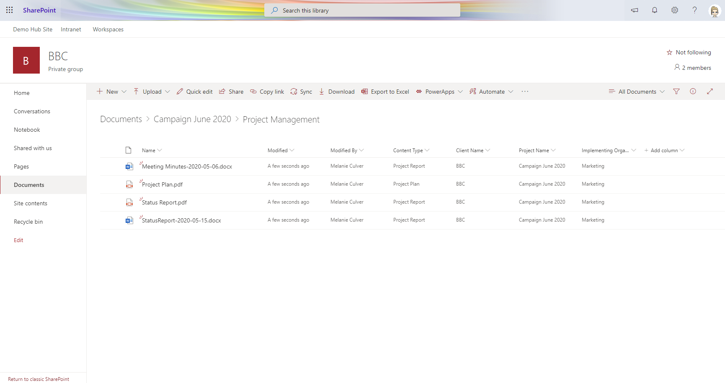
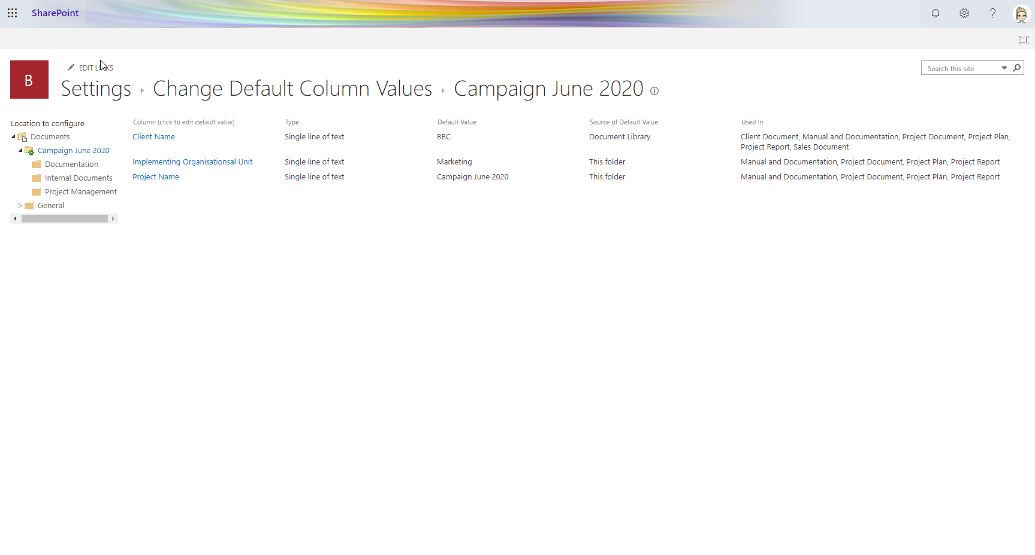
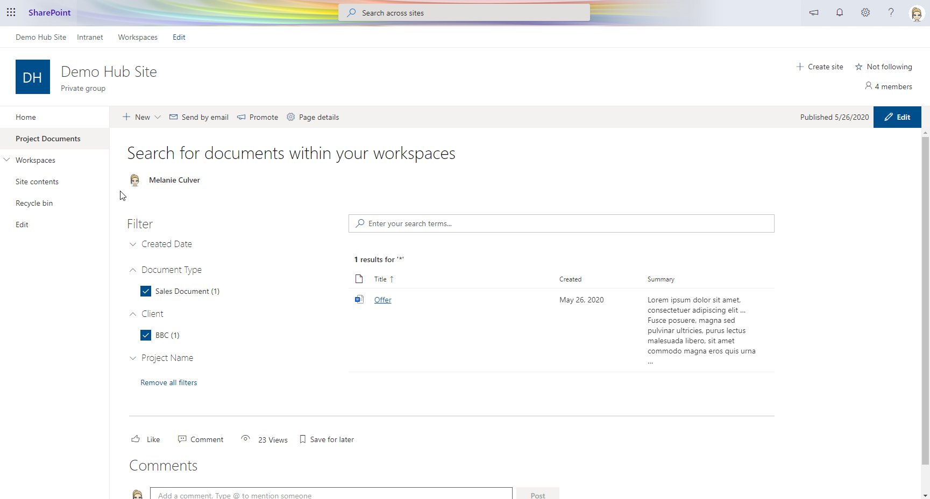
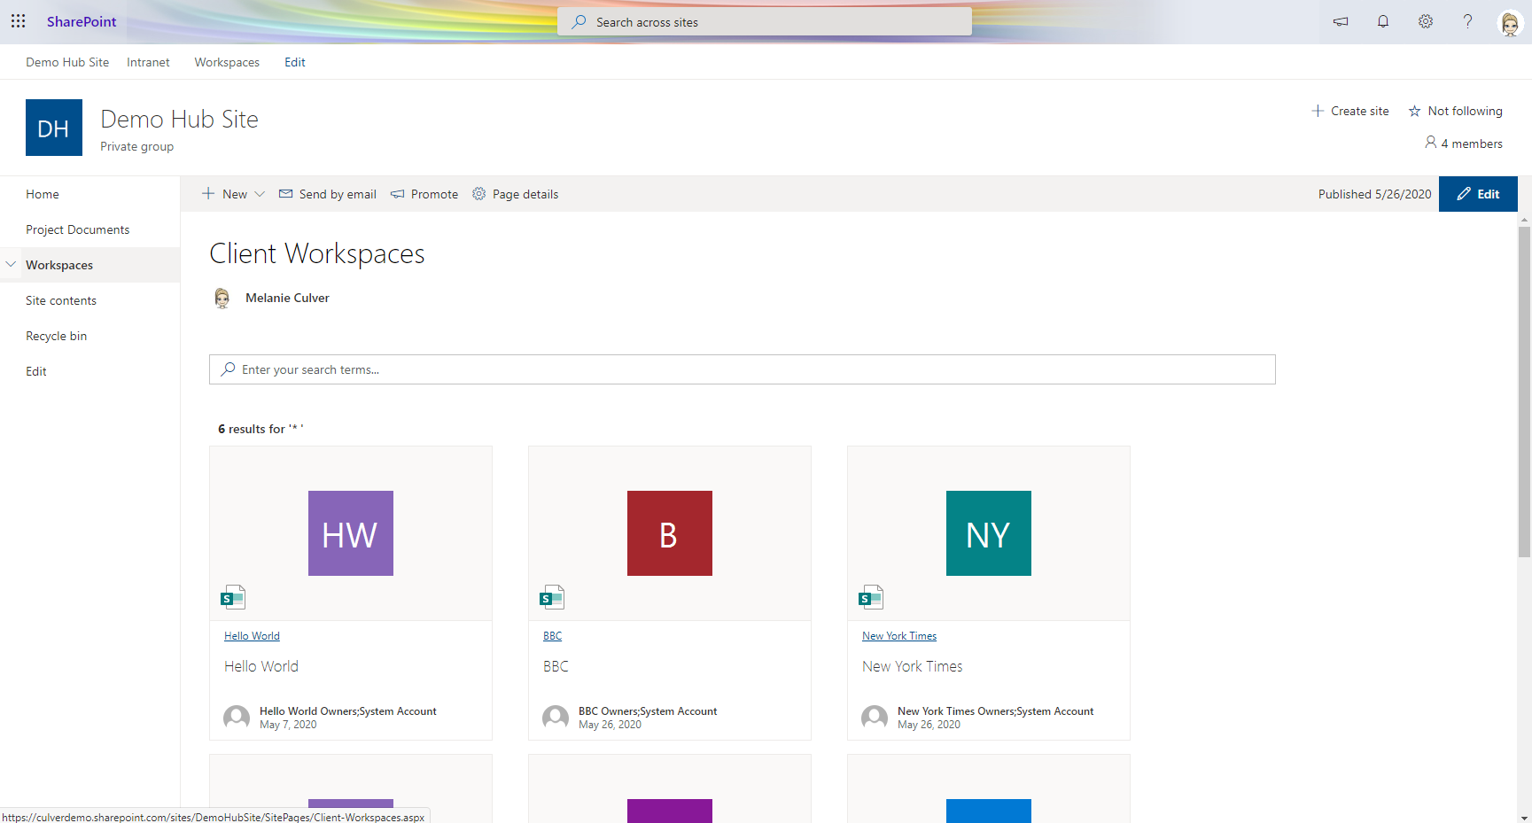

Slide 29
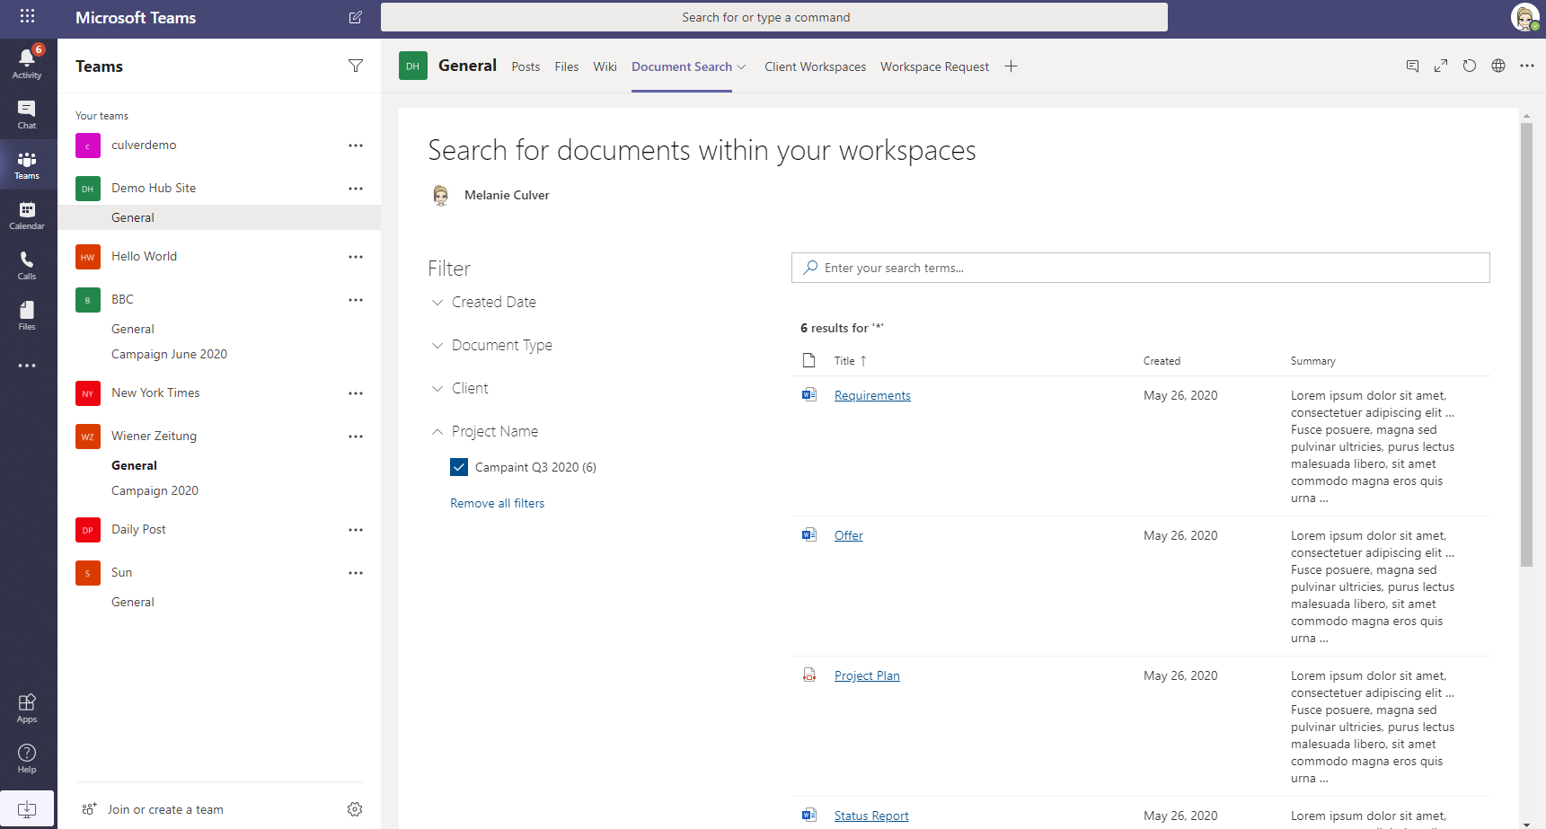
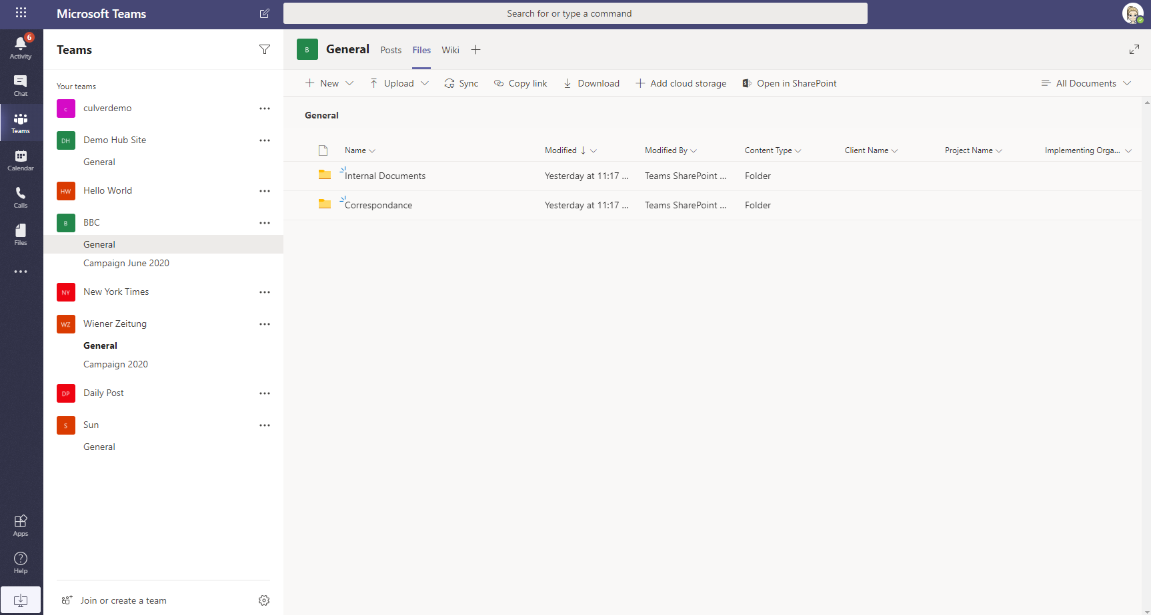
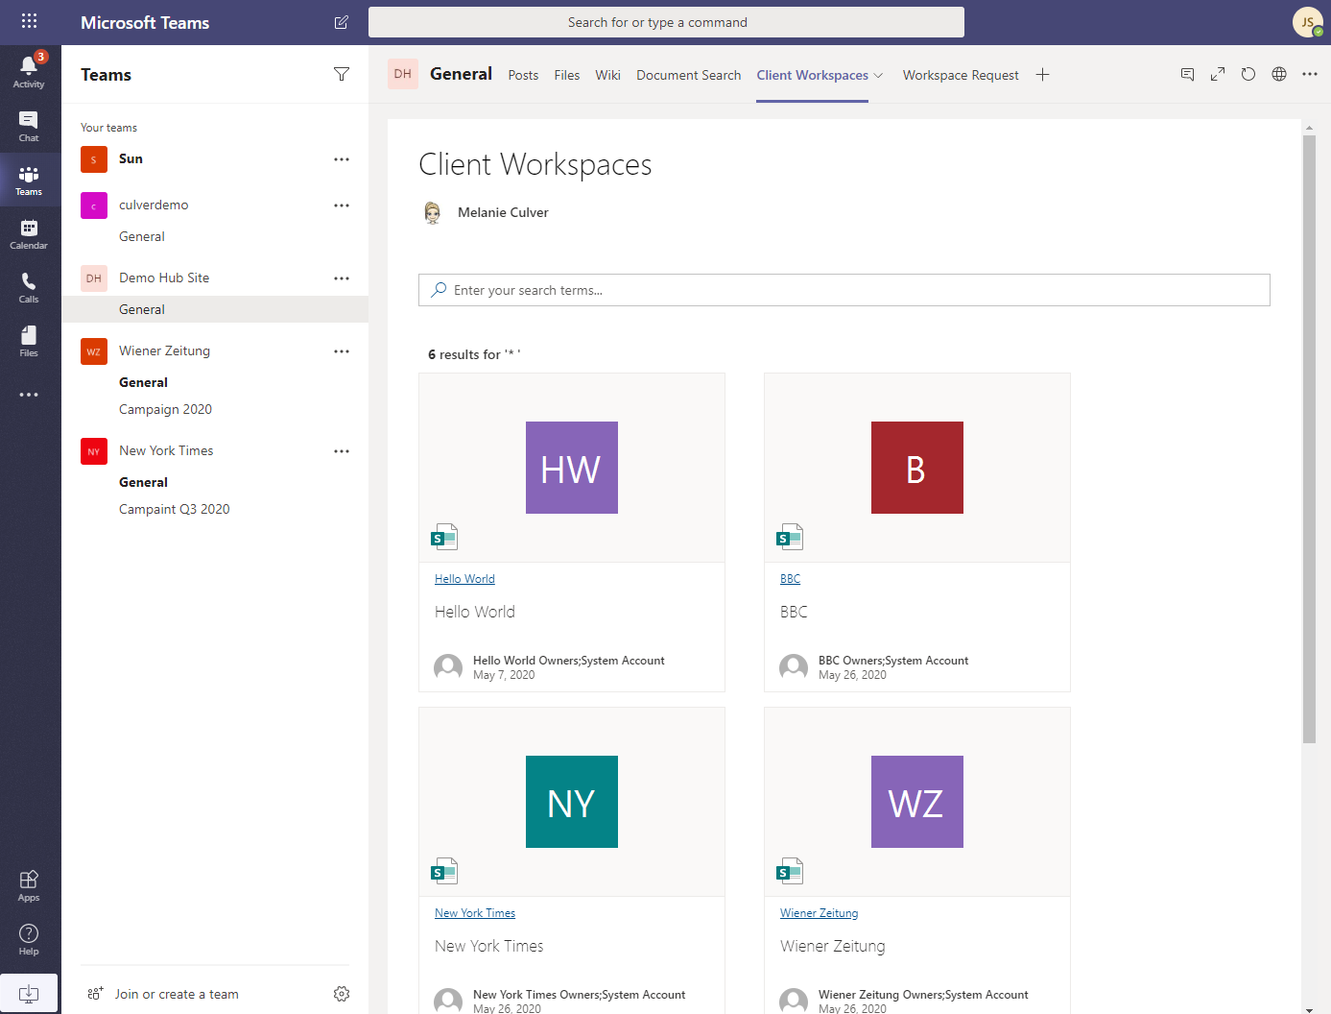

Slide 30
Demo
Notes:
Teams
Create a new team
SharePoint
Metadata – how to set default values for library
Create pre-set of folders per channel for common scenarios
Also pre-set permissions where needed - SharePoint Read All
Hub Site
Common navigation
Search
Teams
Tabs
Virtual folders
Sync folders
Views in files tab

Slide 31


Slide 32





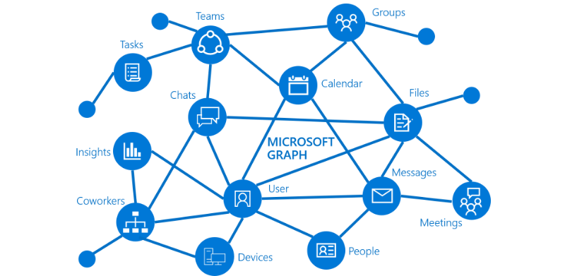


Technologies
Azure Automation
Power Automate
PnP Provisioning Engine
PnP Modern Search
Azure Function
Logic Apps
SharePoint Designer Workflow
Graph API
Azure WebJob

Slide 33
Security
Authentication and Authorisation
AAD App with Graph API
Office CLI
Service Account
SharePoint App

Slide 34
Demo
Notes:
Show request form and request a new Workspace
request new Project
Show underlying Logic App
Show 1 Azure Functions
Show Appy policy function

Slide 35
Recap of Demos
Workflow for Workspaces and Projects
Logic App for processing
Azure Functions for Provisioning
Azure Function for enforcing Teams/SharePoint Policies

Slide 36
Quick Wins
Find a business case – create search pages
Set default meta data
Use Teams Tabs to ping pages & docs
Hide and archive Teams
Forward emails with attachments
Create a single point of access
Standardise your Channels and Libraries
Create Hub Sites
Create PowerBI Reports based on search
Take a look at Project Cortex
….

Slide 37
Final thoughts
Implement quick wins
Let users work where they feel comfortable
Teams, SharePoint and “File System” are ok!
Re-Think if your really need to migrate everything
Train your users to use Office tools efficiently

Slide 38
Kudos to my team ☺
Brought to you by:
The Global Microsoft Community &
#M365VM
M365VirtualMarathon.com
M365Conf.com | #M365CONF

Slide 39

THANK YOU FOR JOINING US!
DO YOU HAVE ANY QUESTIONS?
Let’s Connect: https://at.linkedin.com/in/culvermelanie
Brought to you by:
The Global Microsoft Community &
#M365VM
M365VirtualMarathon.com
M365Conf.com | #M365CONF

Slide 40
Images from https://www.microsoft.com , https://www.rawpixel.com/

